Slide 1
Office of Air and Radiation
Overview
Pat Childers
Alaska Tribal Air Summit

Slide 2
103/105 Tribal Allocation Factors
HQ to the Regions
Step 1
Start with total allocation (approximately $12,000,000.00)
Subtract funding for AIAQTP grant which includes TAMS, ITEP training and professional assistance and the National Tribal Forum on Air Quality
Calculate each regions base funding – half of what they received prior year

Slide 3
103/105 Tribal Allocation Factors
HQ to the Regions
Step 2
Regions are then allocated funds based on the following factors:
  Tribes with 105 (20K)
  Tribes with regulatory TAS (25k)
  Number of TIP's approved (35k)
  Delegated approvals (20K)
  National Network Monitors CASTNet (47k)
  National Network Monitors NCORE (75k)

Slide 4
103/105 Tribal Allocation Factors
HQ to the Regions
Step 3
Regions are then allocated funds based on the additional factors:
  Reservation Population (18%)
  Number Tribes in non-attainment areas (11.5%)
  Number of permitted major sources/synth minor in Indian Country (7.5%)
  Tribes with non-regulatory TAS (5%)
  Number of Tribes (21.5%)
  Number of Tribes operating AQ monitors (17.5%)
  Number of Tribes with completed EI’s (12%)
  Number of Tribes actively addressing toxics (7%)

Slide 5
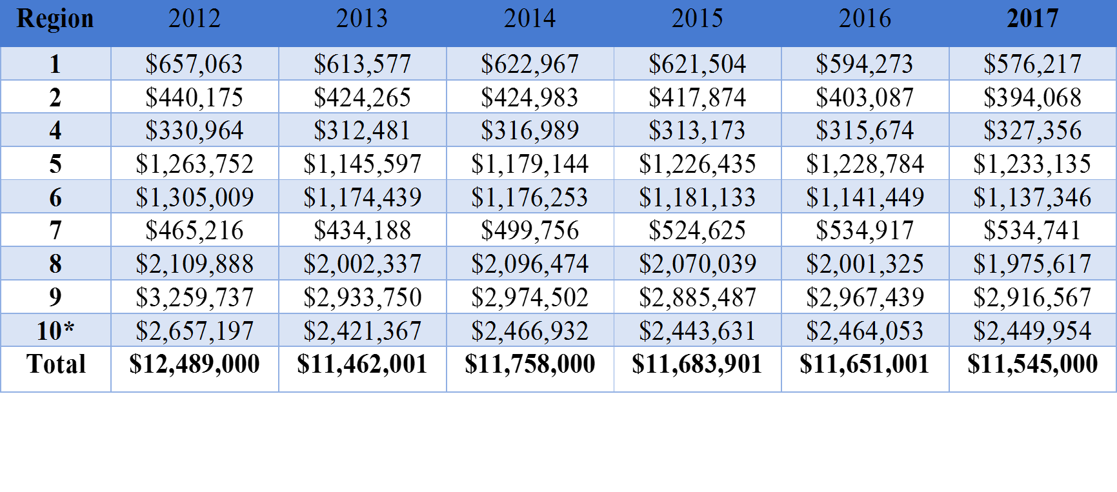
Finished???---Not quite
10 percent Safety Factor Applied – ensures no one region takes too large of a reduction from prior year

Slide 6
Overview of
Office of Air and Radiation
By
Pat Childers
Tribal Program Coordinator
Office of the Assistant Administrator
OAR
Notes:
Good morning. I’m NAME, and I’m going to give an overview of our work here at OAQPS.

Slide 7
OFFICE OF AIR AND RADIATION
Acting Assistant Administrator - Anne Idsal
Deputy Assistant Administrator - Clint Woods (political)
Deputy Assistant Administrator – Betsy Shaw (career)
Tribal Program Coordinator – Pat Childers
Chief of Staff – Ann Campbell
Policy Analyst – Alex Dominguez
Communications – John Millett
Air Quality Assessment Division
Air Quality Policy Division
Health and Environmental Impacts Division
Outreach Information Division
Office of Atmospheric Programs
Office of Transportation & Air Quality
Sector Policies and Programs Division
Clean Air Markets Division
Climate Protection Partnerships Division
Stratospheric Protection Division
Climate Change Division
Office of Radiation and Indoor Air
Assessment & Standards Division
Transportation & Climate Division
Testing & Advanced Technology Division
Compliance Division
Indoor Environments Division
Radiation Protection Division
National Center for Radiation Field Operations
National Air & Radiation Environmental Laboratory
Office of Air Quality Planning and Standards
7
Notes:
OTAQ is one of four programmatic offices within the Office of Air and Radiation (OAR). OTAQ itself has four programmatic divisions - Assessment and Standards, Compliance, Transportation and Climate, and Testing and Advanced Technology.
ADDITIONAL IF NEEDED
The Assessment and Standards Division, ASD, identifies and develops future emission control strategies (such as new vehicle, engine, and fuel quality standards) and national policy on mobile source emission control. The division develops regulations and policies, determines the contribution of mobile sources to air pollution, and assesses the feasibility, cost, benefits, and in-use effectiveness of emission control technologies.
The Compliance Division, CD, develops and implements national air pollution control programs required by the Clean Air Act, Energy Policy and Conservation Act, and Energy Independence and Security Act for vehicles, engines, and fuels. CD staff manage all national clean fuel programs, including the renewable fuel standard, ultra low sulfur diesel, and reformulated gasoline programs. CD staff manage the certification, in-use compliance, and recall programs for U.S. vehicles and engines, including nonroad engines. CD staff oversee fuel economy and CAFE compliance, and develop the Fuel Economy and Green Vehicle Guides. CD is also responsible for information management for the vehicle, engines, and fuels programs. Significant outreach to stakeholders and the public is required.
The Transportation and Climate Division, TCD, leads the OTAQ’s future-focused thinking regarding climate pollutants and transportation planning by developing compelling scenario and policy analyses as well economic modeling tools to quantify GHG reduction of transportation-related emission sources. TCD also leads in addressing disproportionate air pollution impacts from the transportation sector on sensitive populations and nearby communities through the National Clean Diesel Campaign and the Diesel Emission Reduction Act (DERA) grant program. TCD’s SmartWay program reduces emissions from the freight sector by integrating domestic and international freight/supply chain programs and carbon accounting protocols. TCD conducts engineering analyses of advanced technologies for heavy-duty vehicles and equipment to identify opportunities to reduce emissions.
The Testing and Advanced Technology Division, TATD, is responsible for the complete range of tasks required to provide the necessary laboratory testing and support services, IT management services, and advanced technology services at the National Vehicle and Fuel Emissions Laboratory, in support of OTAQ’s most critical compliance and regulatory programs.

Slide 8
Thank You
Any Questions?
Pat Childers
Childers.pat@epa.gov
(202) 564-1082

